Slide 1
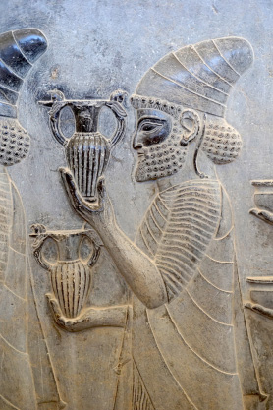

Achaemenid Art and Artisans
A Tactile Exploration of the Apadana Reliefs at Persepolis
Dr. Kiersten Neumann
Curator, Research Associate
The Oriental Institute
neumann@uchicago.edu
2017 Society of Scholars of
Zoroastrianism Conference
Chicago, November 4th, 2017
Notes:
These attendants are from the opposite side of the staircase. They are shown carrying articles
of the king, for example his step stool. We also see a groomsman in very close proximity to a horse, holding the reins tightly in one hand as his opposite arm rests over the animal’s back.

Slide 2
  Outline:
    The Apadana at Persepolis
    Construction and Craftsmen
    Tactility Carved in Stone
    Interacting with Art
Notes:
My talk today has a material basis, with a focus in particular on the reliefs of the Apadana at Persepolis, attributed to the Achaemenid king Darius I. Through a focus on the preserved materials of this great monument, I hope to bring to light traces of the people of the past – both the people who created these carved stone images as the city was being built and those who moved through these space during actual practice. I aim to bring to life their interaction with these works of art by highlighting the ways in which the touch of the craftsmen and artisans created these reliefs, the ways in which their touch is encapsulated in the reliefs, and the ways in which future visitors to this building may have been encouraged or inspired to touch and interact with the reliefs. These various aspects of the Apadana stairway reliefs suggests an intentionality on the part of the craftsmen to express through this work of art certain cultural and socio-political concepts and codes of the Achaemenid royal court, in addition to demonstrating their skill and mastery of their profession.

Slide 3
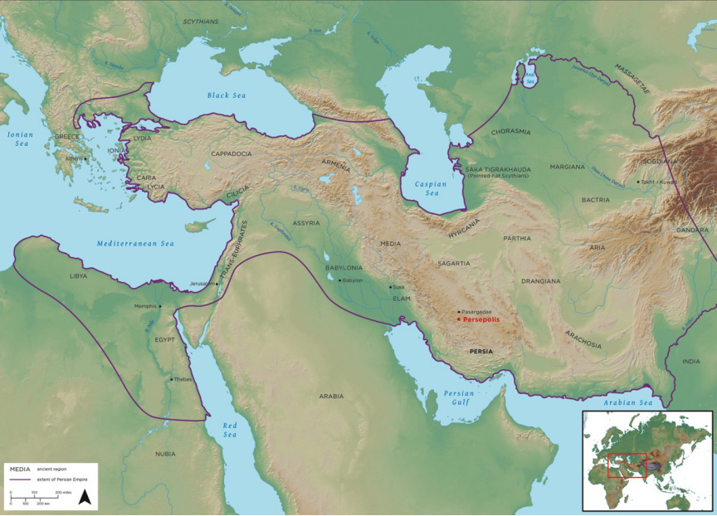
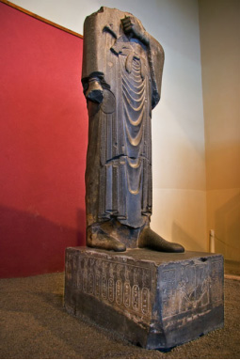
1. The Apadana of Persepolis
Statue of Darius
Notes:
The Apadana was among the first buildings constructed at the city of Persepolis, founded around 520 BCE by Darius the , who ruled from 522 through 486 BCE. Persepolis, as it was called in Greek, meaing “city of the Persians, or “Parsa” in Old Persian, was one of the 5 principal dynastic centers of the Achaemenid Persian Empire, along with Susa, Pasargadae, Ecbatana, and Babylon. This vast empire contained within its boundaries a diversity of peoples and cultures. Though founded by Persepolis, work continued at the site until the fourth century, with later additions by Xerxes, Artaxerxes I and Artaxerxes III, until its destruction in 330 BCE with the arrival of Alexander III of Macedon (or Alexander the Great) and his army.

Slide 4
1. The Apadana at Persepolis
© Persepolis 3D
Notes:
Darius states in inscription that he built a “fortress” where there was none before. This shows a reconstruction of the new platform and buildings constructed as part of Darius’ newly planned citadel, which were meant to serve important political, administrative, and ritual activities at the center of the Fars province; the size of the platform measures 455 by 300 meters.

Slide 5
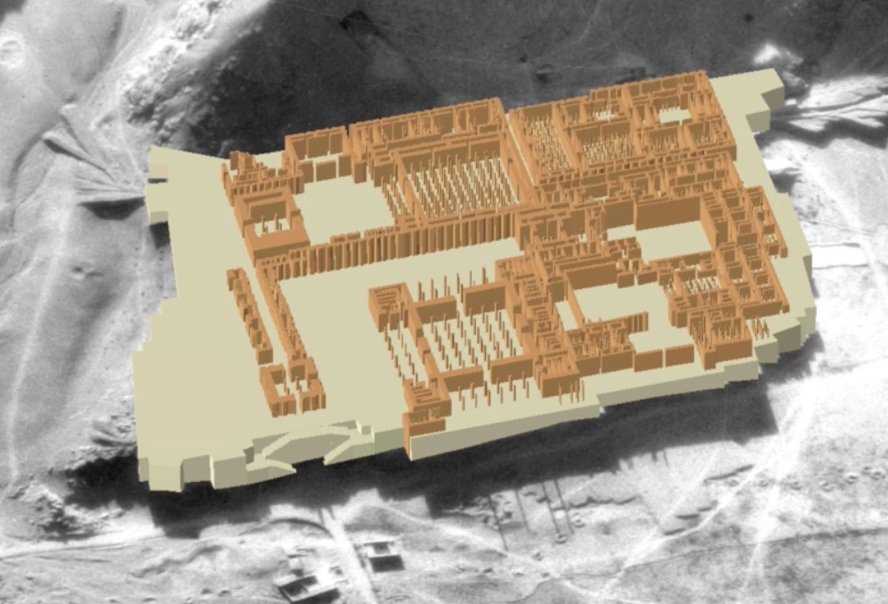
1. The Apadana at Persepolis
Notes:
Reconstruction by CAMEL lab – columned halls

Slide 6
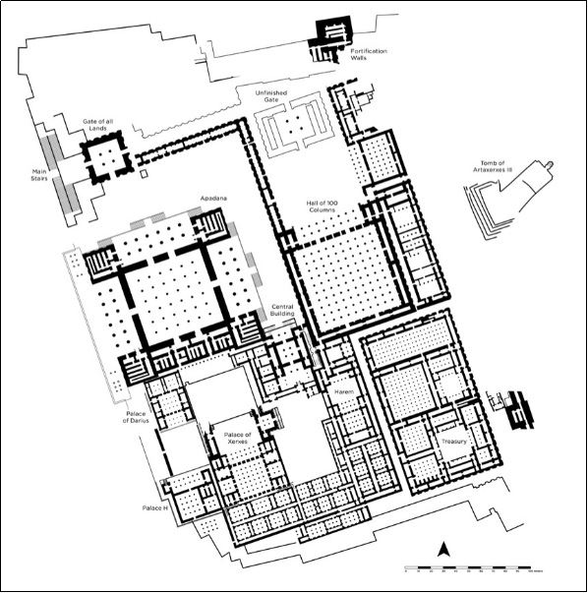
1. The Apadana at Persepolis
Persepolis, 6th – 4th century BCE
Notes:
Overview of the plan of the city, again showing the columned halls, and division of the site into a more public space to the north and more private area to the south, with the palaces, treasury, and so-called Harem.

Slide 7
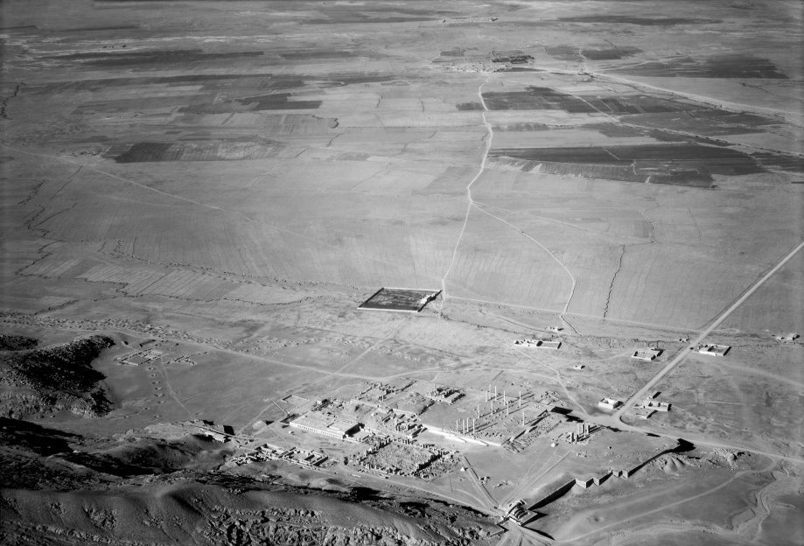
1. The Apadana at Persepolis
Notes:
This 1930s archival image from the Oriental Institute expedition to Persepolis gives the impression that the city existed in isolation, in an uninhabited valley.

Slide 8
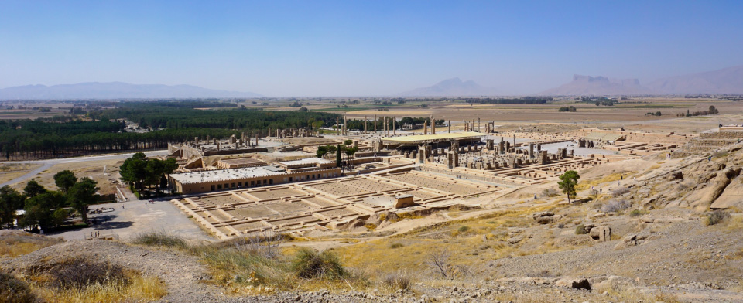
1. The Apadana at Persepolis
Notes:
However, we have a much better understanding of the role of the city today, that is to say that it was located in a highly developed central province of the empire and served important social, economic, and political functions of the state.

Slide 9

1. The Apadana at Persepolis
Persepolis Terrace, 6th – 4th century BCE
Notes:
In the prime location on the terrace was the Apadana, the main audience hall that will be the focus of my talk.

Slide 10
1. The Apadana at Persepolis
Notes:
Reconstruction of the Apadana shows its exterior superstructure, which was made of mudbrick with various embellishments, all of which make a clear statement of conspicuous consumption, a statement of the king’s powers and ability to acquire the resources to build this city and monument.

Slide 11
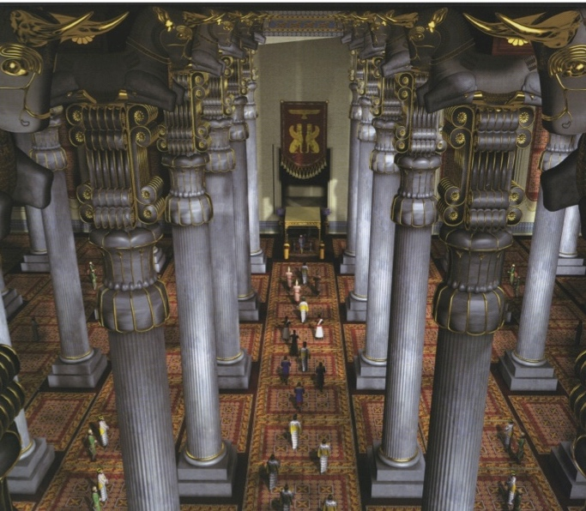
1. The Apadana at Persepolis
“Persepolis Recreated” by Farzin Rezaein, 2004
Notes:
Interior of the building was equally visually dynamic, with an entrance marked by monumental door leaves and 20-meter high columns gilded in gold staggered throughout the inner hall; these were likely painted and were topped with bull protomes carved from stone. This open space was where the king received visitors.

Slide 12
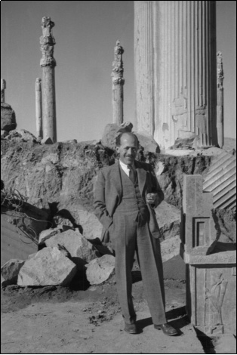
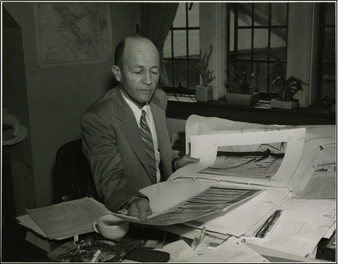
1. The Apadana at Persepolis
Erich Schmidt
Ernst Herzfeld
Notes:
Although the site of Persepolis was known throughout history and documented by various explorers, it wasn’t the focus of scientific expedition until the 1930s when the Oriental Institute received permission to work at the site in order to document and conserve the monuments. The expedition had two directors, Ernst Herzfeld from 1931 to 1934, followed by Erich Schmidt from 1935 to 1939.

Slide 13
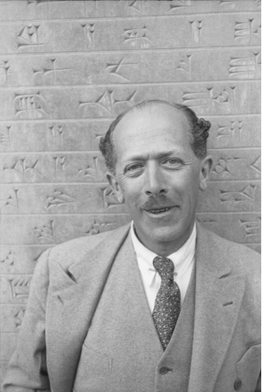
1. The Apadana at Persepolis
Ernst Herzfeld
Notes:
Herzfeld was a student of architecture and art history in Berlin, and had excavated in Mesopotamia prior to coming to Persepolis. He first visited the site in 1905; quotations in his journals relay the lasting impression of romanticism the site had on him. Early in the 1920s he was a visiting lecturer for the Society for National Heritage in Tehran, and during this time he continued to visit Persepolis, document state of monuments, plans, and take photographs of the site. The Act for Antiquities in Iran was approved in 1930, and that same year the Oriental Institute, with Herzfeld as the director, received authorization to work at Persepolis; work began shortly after in 1931.

Slide 14
1. The Apadana at Persepolis
Erich Schmidt
Notes:
Schmidt took over the project in 1935, continuing the work carried out by Herzfeld…

Slide 15
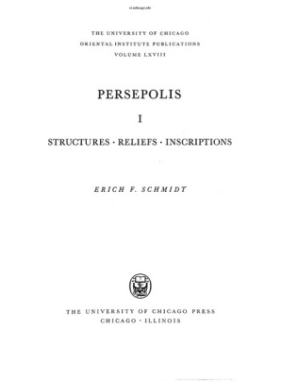

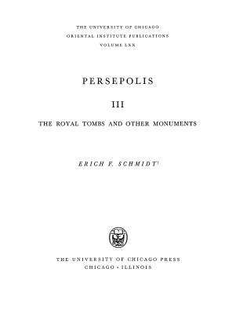
1. The Apadana at Persepolis
OIP 68 (1953)
OIP 69 (1957)
OIP 70 (1970)
Notes:
… and eventually published three volumes on this expedition.

Slide 16
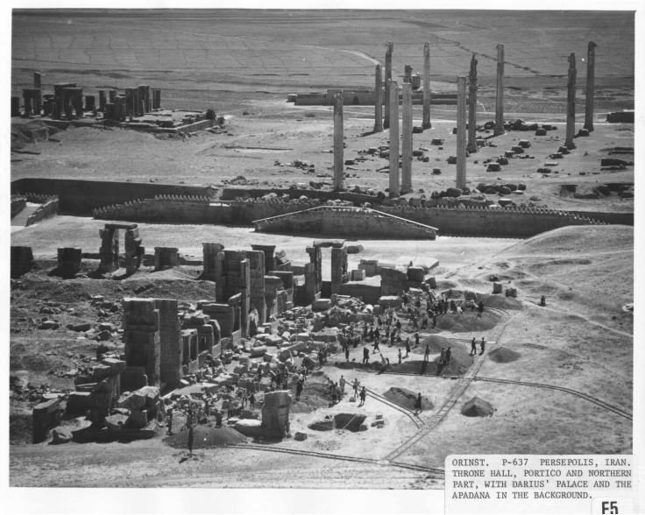
1. The Apadana at Persepolis
Oriental Institute Persepolis Expedition in Iran, 1931–1939
Notes:
Both directors brought with them professional photographs to the site, resulting in an unparalleled collection of images from the 1930s that now reside in the archives of the OI. The photographs document not only the work that was done at the site…

Slide 17
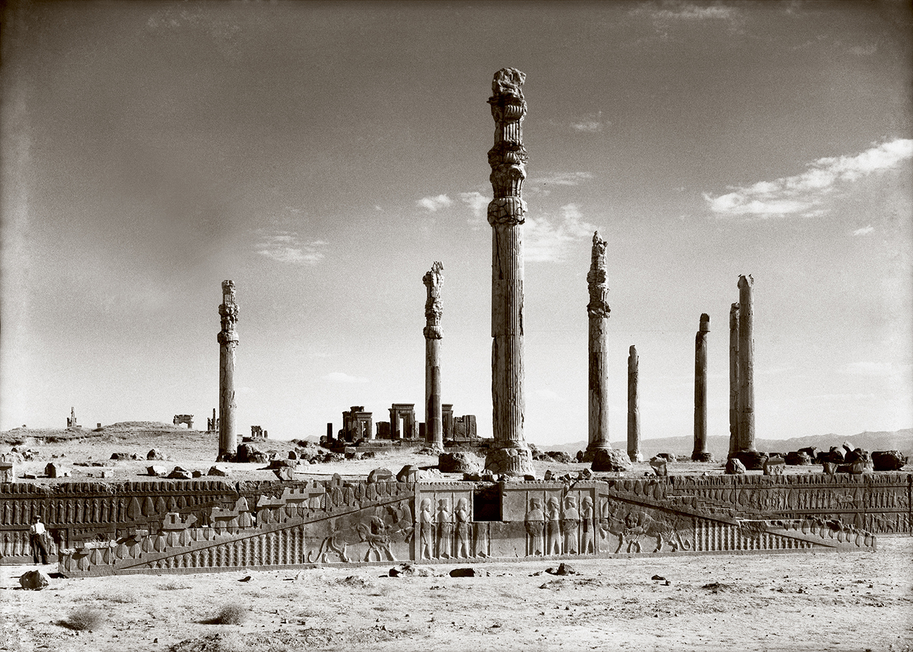
1. The Apadana at Persepolis
Apadana (Audience Hall), Persepolis, 6th – 4th century BCE
Notes:
… but also the grandeur and romantic quality of the city, as well as the incredible state of preservation, which was far more than other major cities of the empire. What is more, the photographs capture the quintessential elements of what is called the “Achaemenid Court Style,” which was initiated by Darius and continued to be adhered to by his successors who built at the site. This style includes: forests of columns, monumental audience halls, elaborate staircases, and stone relief carvings of people from all corners of the empire. All of this comes together in the stairway reliefs of the Apadana, mirror images of which are found on the north and east sides of the building.

Slide 18
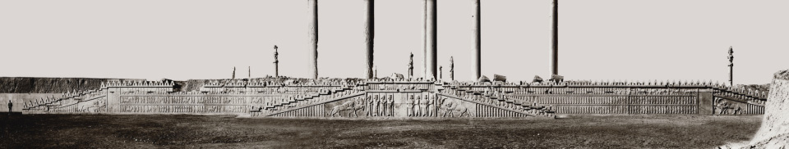
1. The Apadana at Persepolis
Apadana (Audience Hall), Persepolis, 6th – 4th century BCE
Notes:
This photo is of the eastern staircase – here on the left side is depicted 23 foreign delegations bringing tribute to king, in the center are Persian and Median guards, and on the right attendants of the king and noblemen. Overall it can be said to be an idealized representation of the ceremonial activity that would have likely taken place within the building.

Slide 19
2. Construction and Craftsmen
Ernst Herzfeld
Chogha Zanbil
Notes:
With this introduction to the building and the reliefs, I would now like to turn to the second point of my talk – the construction of the stairway reliefs and the craftsmen who were the masterminds behind these incredible works of art. Inspiration for this form of art dates back to much earlier periods that the first millennium. One such monument is found at Chogha Zanbil, near Susa.

Slide 20
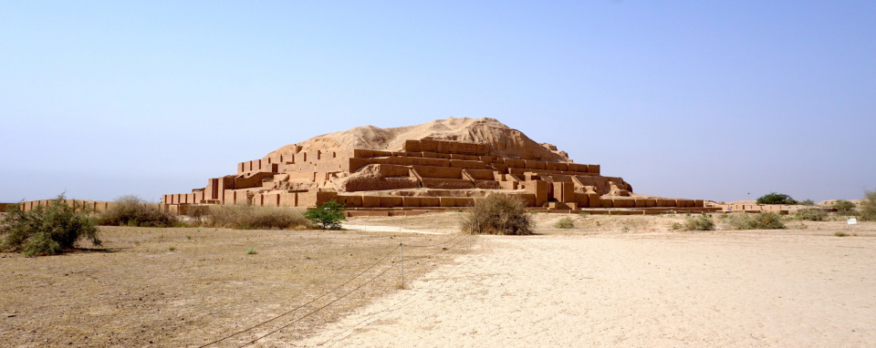
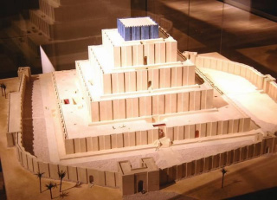
2. Construction and Craftsmen
Chogha Zanbil, Ziggurat, c. 1250 BCE
Notes:
By 2000 BCE there was a clearly defined Elamite culture in this region that was associated with the highlands and was known since prehistoric periods; the capital was located at Susa. The Elamite culture was responsible for building Chogha Zanbil, a monumental mud brick and baked-brick construction, whose named means “large basked-shaped hill,” and which dates to around 1250 BCE.

Slide 21
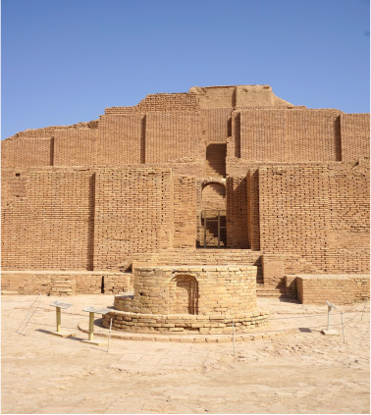
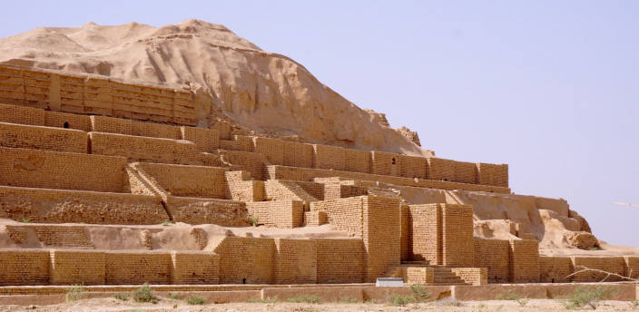
2. Construction and Craftsmen
Chogha Zanbil, Ziggurat, c. 1250 BCE
Notes:
The monument has a square base of 344 feet and was 80 feet tall. It has a very early form of an arch, and on top originally stood a temple. The site fell to ruin in 640 when it was attacked by the Assyrian king, Ashurbanipal.

Slide 22

2. Construction and Craftsmen
Tepe Nush-i Jan, 8th – 6th century BCE
Notes:
Another predecessor to the craftsmanship of the Apadana is found at the site of Tepe Nush-i Jan in western Iran, which dates back to the Iron Age. This is one of the few sites associated with the Median culture of the highlands of Zagros mountains. The monuments were construction in the second half of the 8th century, then abandoned in the 6th.

Slide 23
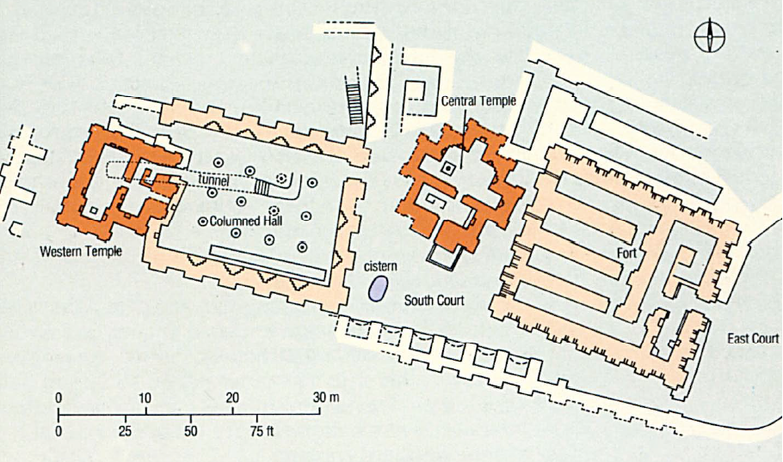
2. Construction and Craftsmen
Tepe Nush-i Jan, 8th – 6th century BCE
Notes:
What is remarkable at the site is the great structure that resembles a fortress – inside is a columned hall, providing an early incarnation of the Apadana of Persepolis. Also noteworthy are the thick enclosure walls that were made of mudbrick.

Slide 24
2. Construction and Craftsmen
Columned Hall, Tepe Nush-i Jan, 8th – 6th century BCE
Notes:
Photograph of the site today.

Slide 25
2. Construction and Craftsmen
Achaemenid Period (c. 550–330 BCE)
Notes:
Both of these sites were eventually taken by king Cyrus, who also eventually took Babylon in 539 BCE, marking the beginning of what is now referred to as the Achaemaenid Persian empire. Cyrus carried out noteworthy construction at both Susa and Pasargadae, his new capital, which continued under successor Darius.

Slide 26
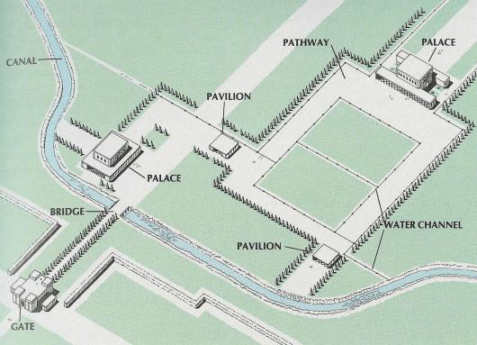
2. Construction and Craftsmen
Pasargadae, 6th century BCE
Notes:
One aspect is the unprecedented use of monumental stone architecture with reliefs and columned halls. The entrance to the city was marked by a gate followed by gardened walkways and bridges that led to the palaces and pavilions. These qualities drew on elements of preceding and neighboring cultures, for example the new concept of space, with buildings that are very open and welcoming.

Slide 27
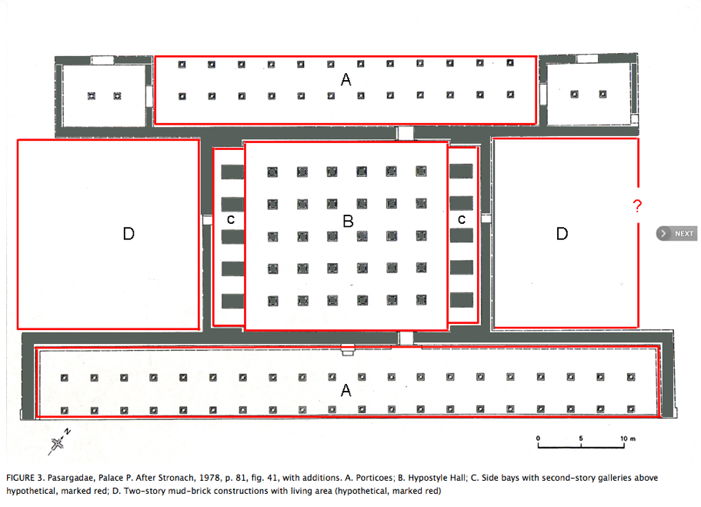
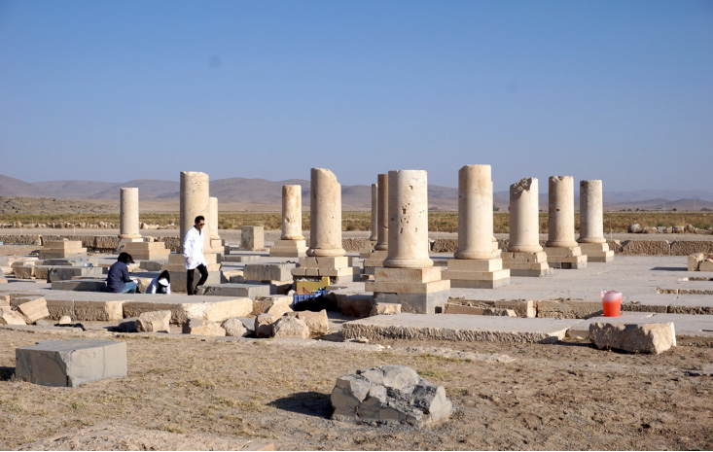
2. Construction and Craftsmen
Palace P, Pasargadae, 6th century BCE
Notes:
Palace P was one such monument – the columns, the lower sections of which are still standing at the site today, show the fine stone working that was employed in constructing the city.

Slide 28
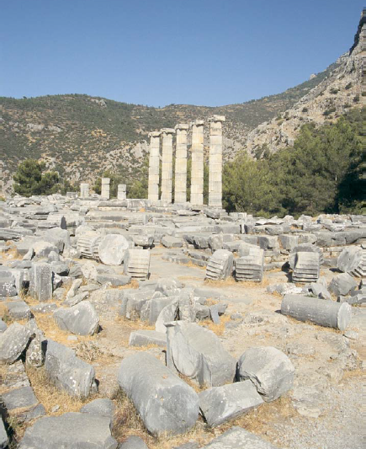
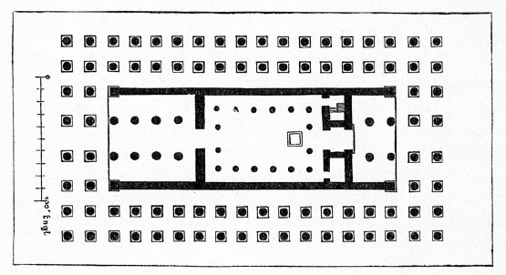
2. Construction and Craftsmen
Temple of Artemis, Ephesus (c. 560 BCE) Priene, Turkey
Greeks / West
Notes:
As I mentioned, this use of stone was not yet common to the region, but rather was likely introduced by Cyrus as a result of his travels throughout Anatolia, where craftsmen and carvers were building large temples entirely of stone, including columned porticoes – a prime example being the temple of Artemis at Ephesus and temples at the site of Priene.

Slide 29
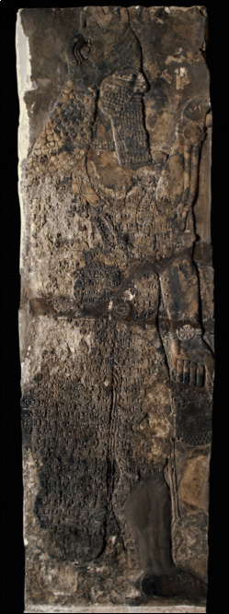
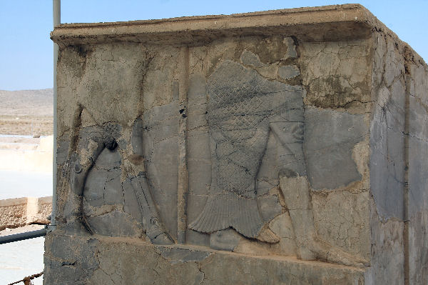
2. Construction and Craftsmen
Palace P, Pasargadae, 6th century BCE
Notes:
In addition to stone columns, buildings as Susa also contained carved stone reliefs, in particular in doorjambs to the palaces. This example of a doorjamb shows the lower portions of two mythological figures – a bull-man and a fish-man. The relief to the right shows the inspiration for this type of carving; it is a relief from an Assyrian temple at the site of Nimrud, ancient Kalhu. These figures were protective beings that guarded the entrances to royal buildings.

Slide 30
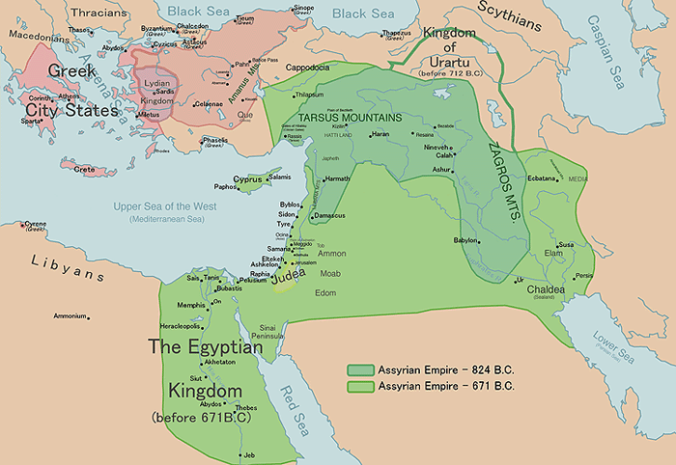
2. Construction and Craftsmen
Carchemish, early 1st millennium
Notes:
Inspiration for this tradition similarly included examples from outside of the Assyrian heartland, with some of the expertise and impetus for this style of architectural decoration coming from the west, specifically in the area of Syria from sites associated with the Neo-Hittite culture of the early first-millennium BCE.

Slide 31
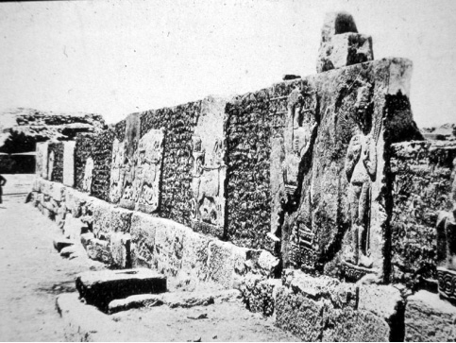
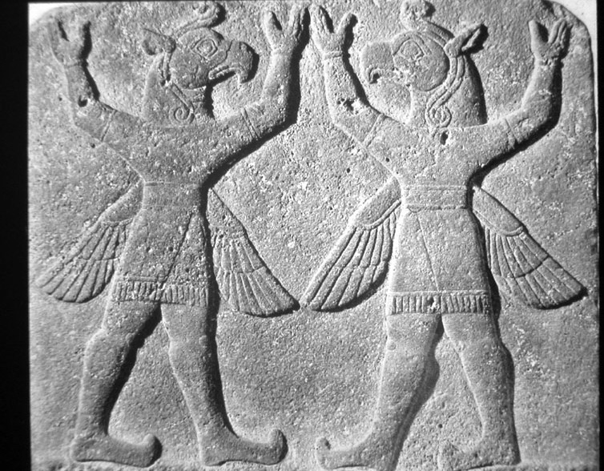
2. Construction and Craftsmen
Carchemish, early 1st millennium
Notes:
Similar to the reworking of the art form to match the demands of the Achaemenid Court Style, the Assyrians took inspiration for the wall reliefs found on exterior gates and walk-ways at such sites cities as Carchemish, beginning with the first king of the Neo-Assyrian empire, Ashurnasirpal II, who campaigned in this region to the west of the heartland of this empire.

Slide 32
2. Construction and Craftsmen
Throne Room, Northwest Palace, Nimrud
Notes:
The king and his craftsmen then introduced this form of art not only on the exterior of buildings but also on the inside of their palaces and temples. This examples shows such reliefs around the lower section of the throne room of the Northwest Palace.

Slide 33
2. Construction and Craftsmen
Assyrian Carved Stone Wall Reliefs, 9th century BCE
Notes:
In addition to mythological figures, the Assyrian reliefs also depicted militaristic scenes and formal scenes involving the king, comparable examples of which we’ll also see when we turn to the Apadana reliefs.

Slide 34
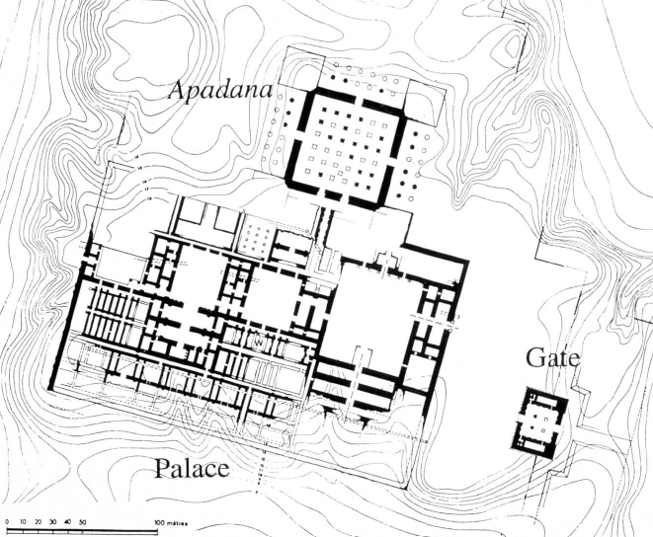
2. Construction and Craftsmen
Susa under Darius I, 549–486 BCE
Notes:
One additional building worth mentioning is the Apadana that Darius built at Susa. As I mentioned, Darius was involved in construction at Pasargadae, completing some of the buildings of his father Cyrus. Yet he also carried out a building project at Susa, adding a great audience hall with carved stone sculpture and great columns as seen at Pasargadae.

Slide 35
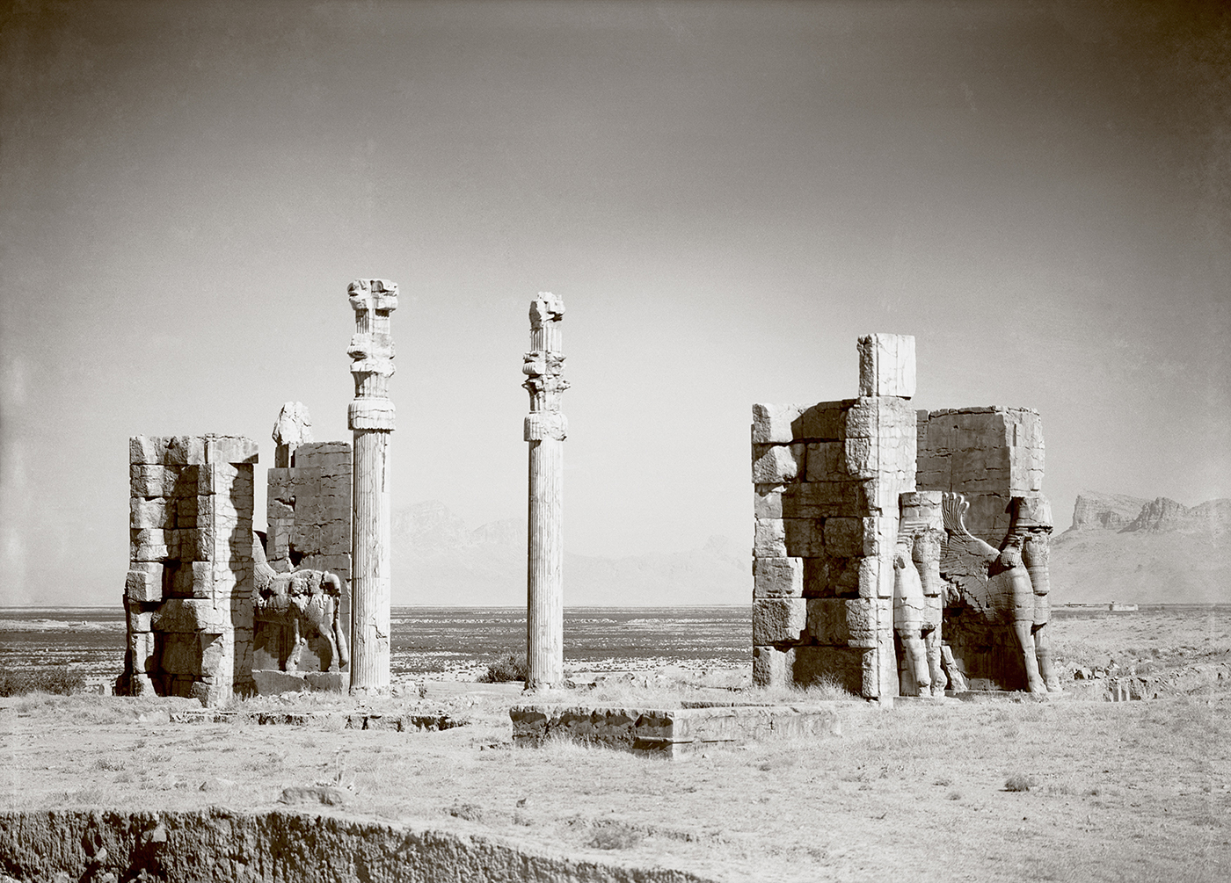
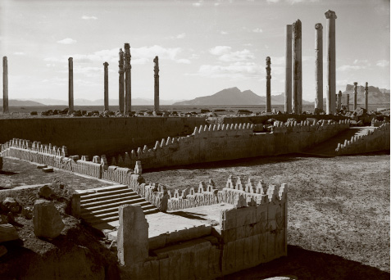
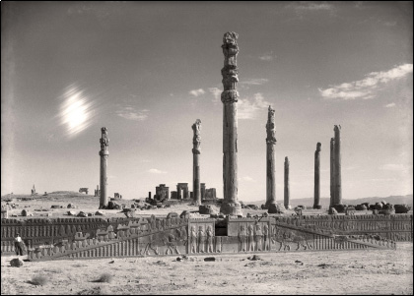
2. Construction and Craftsmen
Persepolis, 6th – 4th century BCE
Notes:
This early practice may have helped Darius prepare for executing the monuments of Persepolis, which draw on these earlier examples. It might be said that the full expression of Achaemenid Court Style as well as the craftsmanship that comes to define the Achaemenid period was fully realized at Persepolis, Darius’ newly minted city. The craftsmen that he would have brought with him, the men whose skilled hands and learned touch brought to life the great monuments and the reliefs of the Susa and Pasargadae, were his accomplices in this venture.

Slide 36
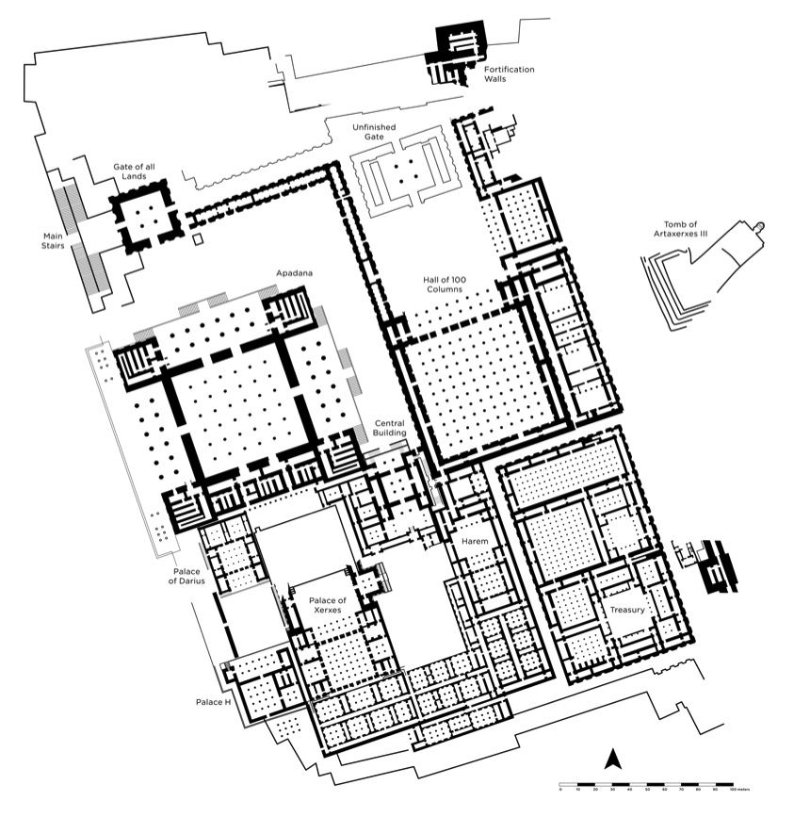
2. Construction and Craftsmen
Apadana (Audience Hall), Persepolis, 6th – 4th century BCE
Notes:
At Persepolis, one of their great feats was the Apadana and its accompanying stairway reliefs. The practice the carvers would have had at earlier sites, and tips they may have acquired from craftsmen of other areas of the ancient Near East, bolstered the execution of this grand sequence of stone reliefs.

Slide 37
2. Construction and Craftsmen
Apadana (Audience Hall), Persepolis, 6th – 4th century BCE
Notes:
In other words, the Apadana reliefs became an outlet for the growth of this artistic tradition with a new level of expression and artistry. Not only does the overall execution provide access to these professionals, but the details of the carving offer a glimpse of their hands at work.

Slide 38
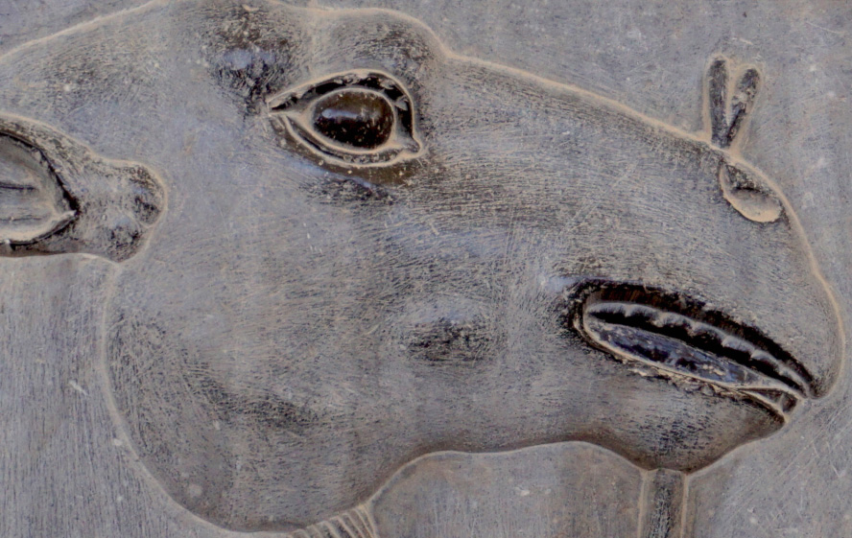
2. Construction and Craftsmen
Apadana (Audience Hall), Persepolis, 6th – 4th century BCE
Notes:
What I mean by this is that if you look very closely at the reliefs, you can see evidence of the touch of these craftsmen, in particular their tool marks on the hard limestone, but also the attention to detail that they maintained throughout the composition – for example the tool marks on the face of this camel, and the execution of his eye and lips.

Slide 39
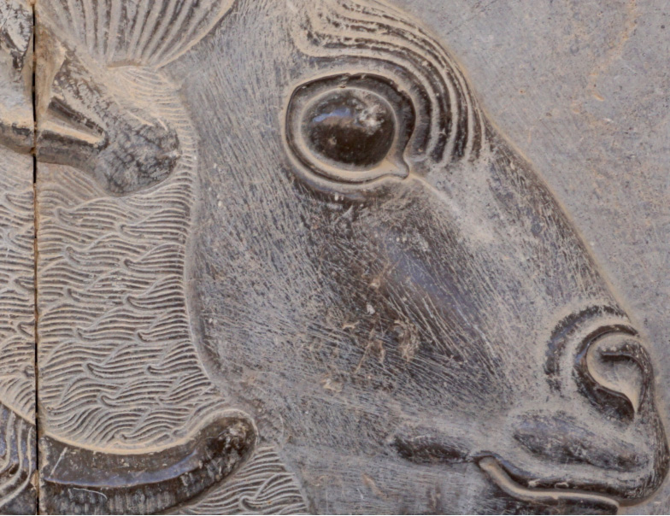
2. Construction and Craftsmen
Apadana (Audience Hall), Persepolis, 6th – 4th century BCE
Notes:
The same can be said of the head of this ram, the eyes and nose but also the tuffs of fur on its neck. Amidst all of this are the tools of the workmen that are still visible.

Slide 40
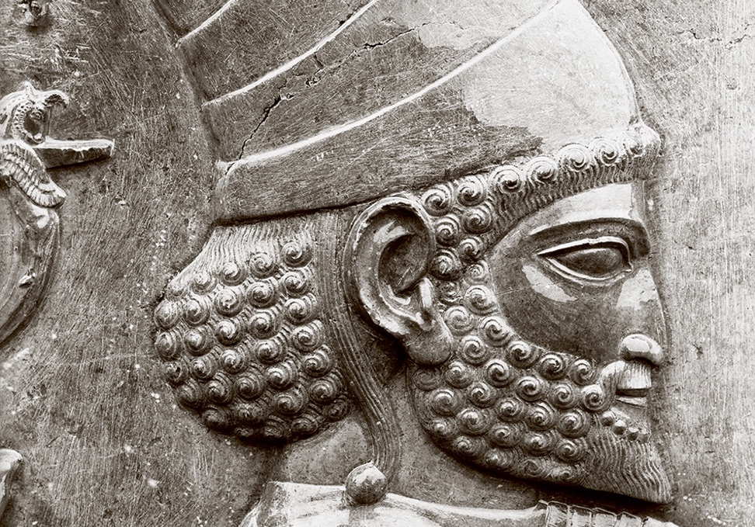
3. Tactility Carved in Stone
Apadana (Audience Hall), Persepolis, 6th – 4th century BCE
Notes:
Even such minor details as the ties on footware received the same level of attention. From the largest to the smallest element, the craftsmen ensured that every element was perfect.

Slide 41
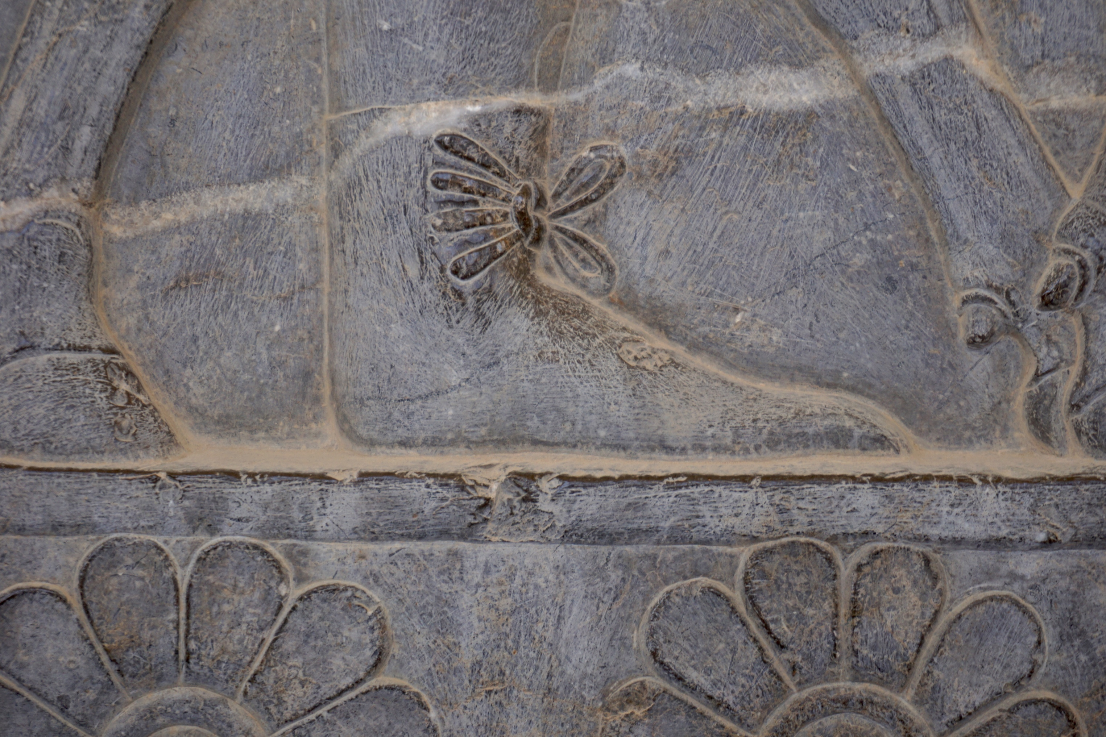
3. Tactility Carved in Stone
Apadana (Audience Hall), Persepolis, 6th – 4th century BCE
Notes:
Detail: carving technique

Slide 42
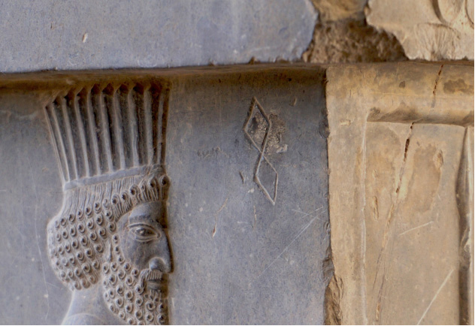

2. Construction and Craftsmen
Apadana (Audience Hall), Persepolis, 6th – 4th century BCE
Notes:
But the craftsmen didn’t just leave their “touch” on the reliefs through the traces of their carving tools and the finessed details, but they also intentionally left their mark in form of what we now call “maker’s marks.” In the image on the left, to the right of the figure, are two diamonds, one on top of the other like a figure-eight. This one in particular was placed just below the overhand of the reliefs on the top of the staircase. This same symbol has been found on other reliefs at Persepolis, including some in the palaces of the kings, so not just the Apadana. Whether these are marks of an individual craftsman, similar to a person’s signature today, or whether it was the mark of a group of craftsmen or guild is hard to say. Regardless, there is no questioning the intentionality of this mark, and the desire for the craftsman or men to leave a symbol of their touch, or their hands on the relief itself, that, when any person moving past the relief saw, would have been reminded of the process of creation of these works of art and the men responsible for them.

Slide 43
3. Tactility Carved in Stone
Delegations with Ushers
Guards
Guards, Attendants,
Noblemen
Notes:
For the third aspect of the tactile aspect of the reliefs, I will now turn to their finished form and the representation of touch in the imagery itself.
As I briefly mentioned earlier, there were two monumental stairways that allowed a person to enter the Apadana at Persepolis, one was on the north side, closest to the main gateway leading up to the terrace – the Gate of All Lands. The other staircase was on the east side, facing the 100-Columned Hall. The staircase on the north side had been exposed throughout much of history. However, that on the east side was newly exposed during the Oriental Institute’s work at the site in the 1930s. For this reason, it is the better preserved of the two. Yet the two are mirror images of one another. So, where one element isn’t preserved on one staircase, the other staircase may fill in that void, should that section be preserved there.

Slide 44
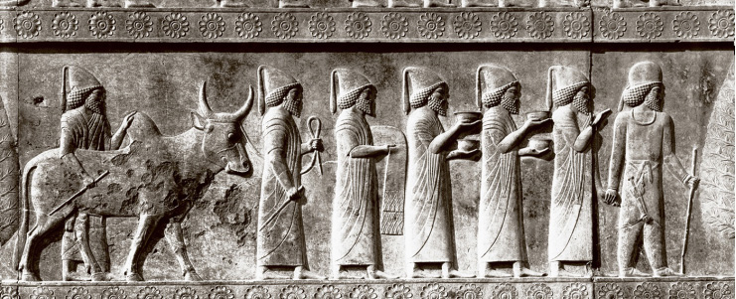
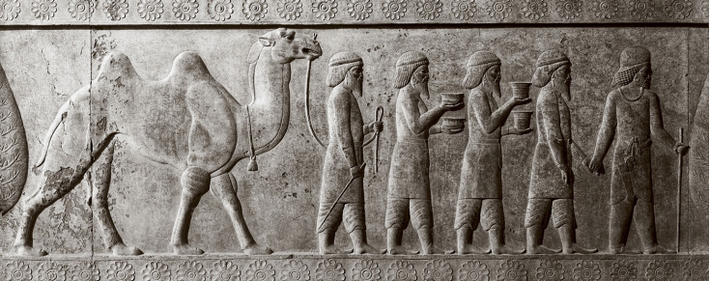
3. Tactility Carved in Stone
Left Side
Notes:
To the left were 23 delegations bringing tribute to the king divided by cypress trees and led by Median and Persian Ushers. This photograph, one of the OI archival images, shows the detail of each figure. There’s been disputes in past over the identification of these groups, which is in part based on materials they carry and garments (all different). Sometimes they are connected to an inscription from Darius’ tomb of 23 delegations, though at a different site.

Slide 45
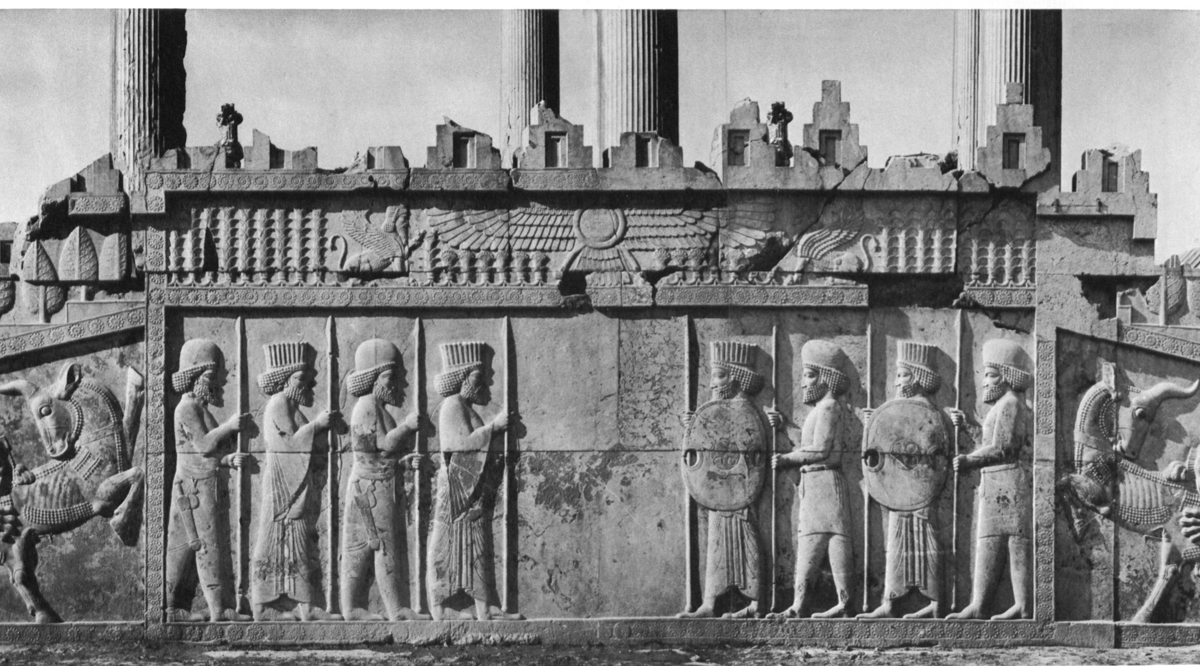
3. Tactility Carved in Stone
Central Panel
Notes:
The central panel consisted of guards in Persian and Median dress. The Medes have domed hats, carry short sword (akinakes) attached to their belts, and the Persians have fluted tiaras, and carry a figure-of-eight shield (dipylon).

Slide 46
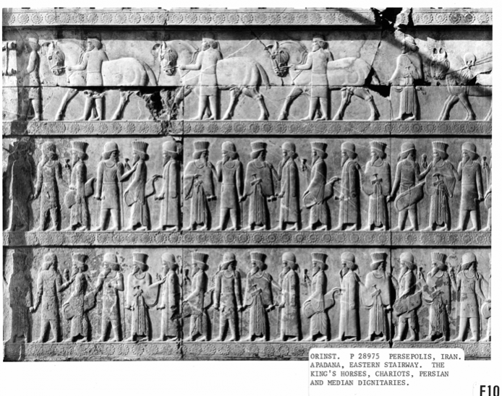
Right Side
Notes:
The right side included additional guards, as well as attendants and noblemen.

Slide 47
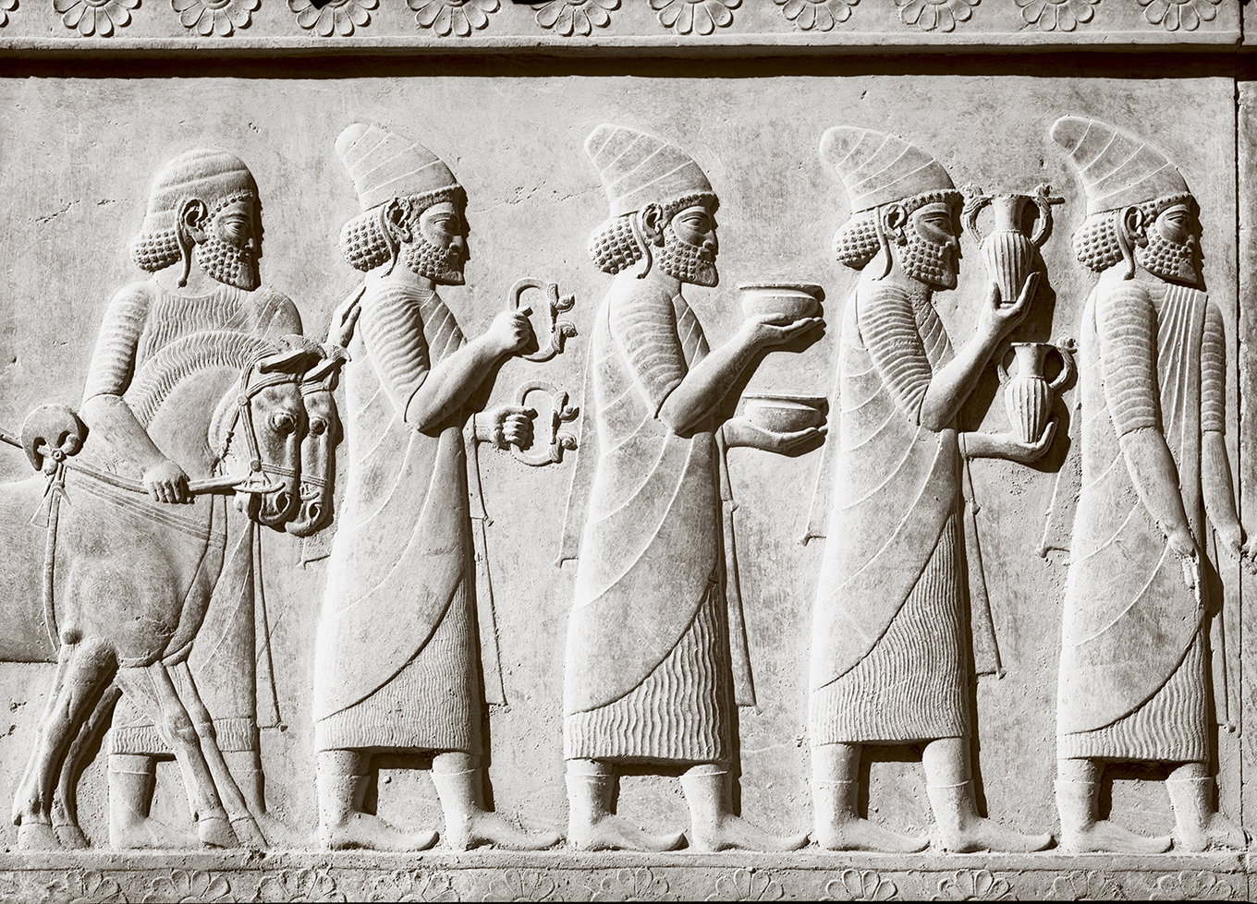
3. Tactility Carved in Stone
Apadana (Audience Hall), Persepolis, 6th – 4th century BCE
Notes:
The depiction of the delegations carrying tribute for the king represent some of the most interesting representations of touch, that is to say, the way that they are shown holding vessels or engaging and controlling animals. The detail and variation that is show with each figure and each object shows close dedication on the part of the craftsmen.

Slide 48
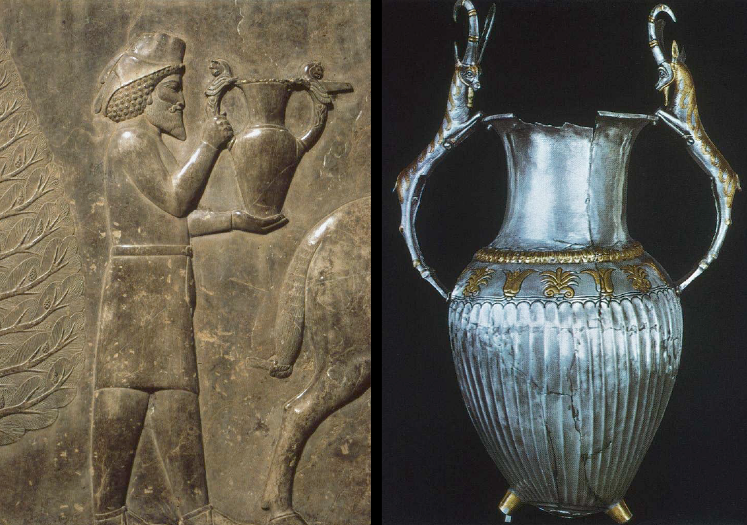
3. Tactility Carved in Stone
Apadana (Audience Hall), Persepolis, 6th – 4th century BCE
Notes:
As with this correlation, they would have been basing their representations on real life examples, thinking of form and weight and the material they were made of.
- Armenian = Gilt silver vessel, no provenance

Slide 49
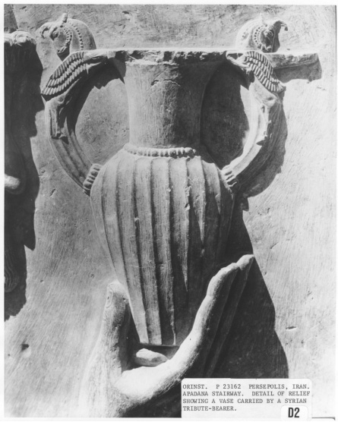
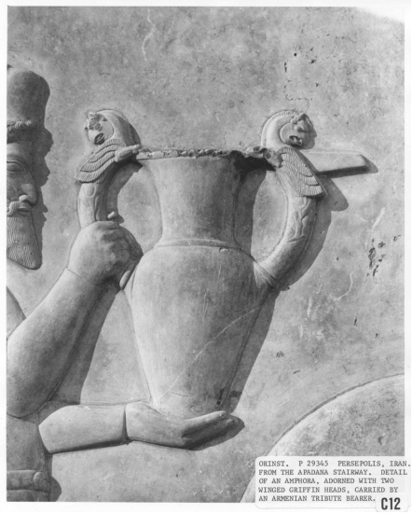
3. Tactility Carved in Stone
Notes:
Here are representations of two similar yet slightly different vessels. The way that the tribute bearers’ hands are done is also slightly different, taking into account the exact shape of the base of these tall vessels.

Slide 50
3. Tactility Carved in Stone
Notes:
The same is true of these shallow bowls, the bearers’ hands shown flat in order to accommodate the varying shapes, their thumbs cupping the exterior.
Apadana, detail of gifts carried by an Ionian tribute bearer, P. 29347. Print from Persepolis and Ancient Iran: Catalog of Expedition Photographs, 3D8.
Apadana, detail of gold vessels, carried by a Bactrian tribute bearer, P. 29348. Print from Persepolis and Ancient Iran: Catalog of Expedition Photographs, 3D9.

Slide 51
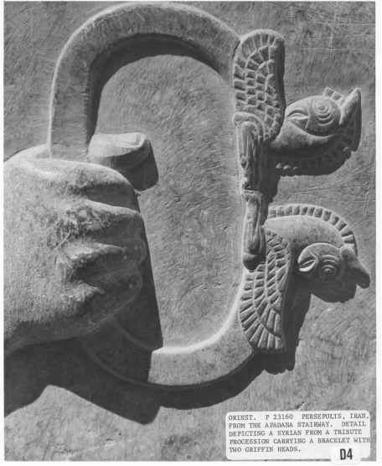
3. Tactility Carved in Stone
Notes:
Here too with the tight gripping of the bracelet with griffin heads at two ends.
Apadana, detail of a bracelet with two griffin heads, carried by a Syrian tribute bearer, P. 23160. Print from Persepolis and Ancient Iran: Catalog of Expedition Photographs, 3D4.

Slide 52

3. Tactility Carved in Stone
Notes:
This figure is shown carrying two baskets with containers inside using a pole suspended across his shoulders. The representation perfectly communicates the weight of these baskets through the slight bend in the pole, the individual bracing against this weight.
IRAN: Persepolis Apadana, E. Stairway, and Indian tribute bearer carrying perfume bottles
- bending of the pole, shoulder muscles – bracing against the weight

Slide 53

3. Tactility Carved in Stone
Notes:
Yet another figure carries a skin of an animal over his shoulder, clasping the leg so that it doesn’t fall back.
Apadana, East Stairway, detail of the bearer of an animal skin in the Arian (?) delegation. P. 24944. Print from Persepolis and Ancient Iran: Catalog of Expedition Photographs, 3A4.

Slide 54


3. Tactility Carved in Stone
Notes:
Some attendants carry textiles draped over their arms and hands.
Details: Section three of the panorama (P 28998-29002), numbered from left to right, of the lower register of the left side of the apadana stairway (K).

Slide 55

3. Tactility Carved in Stone
Notes:
Also of note is the way in which the tribute bearers are shown interacting with animals, whether leading them from the front with a rein or walking at their side.
Persepolis, Iran. Apadana, East Stairway, detail of the Indian delegation in the tribute procession. P. 23145. Print from Persepolis and Ancient Iran: Catalog of Expedition Photographs, 2E3.

Slide 56

3. Tactility Carved in Stone
Notes:
Here the figure’s hand rest tactfully on top of the animal’s side and on its back….

Slide 57

3. Tactility Carved in Stone
Notes:
The same in this image.

Slide 58

3. Tactility Carved in Stone
Notes:
Persepolis, Iran. Apadana, East Stairway, detail of the Indian delegation in the tribute procession. P. 23145. Print from Persepolis and Ancient Iran: Catalog of Expedition Photographs, 2E3.

Slide 59

3. Tactility Carved in Stone
Notes:
This close-up shows such an attention to detail, the different direction of the fur for example.
Persepolis, Iran. Apadana, East Stairway, detail of the Indian delegation in the tribute procession. P. 23145. Print from Persepolis and Ancient Iran: Catalog of Expedition Photographs, 2E3.

Slide 60

3. Tactility Carved in Stone
Notes:
These attendants are from the opposite side of the staircase. They are shown carrying articles of the king, for example his step stool. We also see a groomsman in very close proximity to a horse, holding the reins tightly in one hand as his opposite arm rests over the animal’s back.
East Stairway, detail of the procession depicting the king's riding horse and camp stool. P. 22261. Print from Persepolis and Ancient Iran: Catalog of Expedition Photographs, 2F9.

Slide 61

3. Tactility Carved in Stone
Notes:
The interactions of animal with animal, though far fewer, are also noteworthy. Here is an example of the battle between bull and lion that is found on all of the staircase at Persepolis. What is particular interested is how the bull touches up on the border of the scene.

Slide 62

3. Tactility Carved in Stone

Slide 63

3. Tactility Carved in Stone
Notes:
Another category of touch is person to person. Here we see ushers on the left side of the relief leading delegations by hand, a demonstration of the social hierarchy of the scene.

Slide 64

3. Tactility Carved in Stone
Notes:
The opposite side of the reliefs shows more of an equality of touching gestures, with figures facing both forwards and backwards, interacting with each other through clasped hands or hands on shoulders.
ersepolis Period: Achaemenid Period, ca. 500 B.C. Details: Section two of the panorama of the three registers of the right side of the apadana stairway (K). P28974-80, numbered from right to left, comprise the entire panorama of the right side. King's horses, Persian and Median dignitaries.

Slide 65


3. Tactility Carved in Stone
Notes:
Additional examples
Persepolis, Iran. Apadana, East Stairway, detail of Persian and Median dignitaries. P. 22790. Print from Persepolis and Ancient Iran: Catalog of Expedition Photographs, 2G1.
Apadana, East Stairway, detail of a Mede, P. 23176. Print from Persepolis and Ancient Iran: Catalog of Expedition Photographs, 3B6.

Slide 66
3. Tactility Carved in Stone
Notes:
This image shows the central panel with the guards at the bottom, carved during the reign of Xerxes. The image on top shows the original panel of Darius that was recovered in another building on the site.

Slide 67

3. Tactility Carved in Stone
Treasury Relief, Persepolis, 6th – 4th century BCE
Notes:
In front of the seated king individual with hand to mouth in a gesture of humility and respect; behind the king is the crown prince with hand raised. Here we see an emphasis on these gestures and the formalized communication that is shown through touch and hands.

Slide 68


3. Tactility Carved in Stone
Sealing, Treasury, Persepolis, 6th – 4th century BCE
Notes:
This same scene, a presentation scene, is found on sealings from Persepolis – chunks of clay that were used to seal vessels.
- same presentation scene
- PFUTS 305*

Slide 69

3. Tactility Carved in Stone
Treasury Relief, Persepolis, 6th – 4th century BCE
Notes:
This scene from a reconstruction video of the Apadana shows figures presented to the king in the Apadana in this very practice, making the same gesture.

Slide 70


4. Interacting with Art
Notes:
The last topic I wanted to look at is the interaction of people with the reliefs. Traditional emphasis is often place on how we look at and see these reliefs, what it’s like to be a viewer. But I would argue that there was also a tactile way that people may have engaged with the reliefs, as with other forms of art. This picture from the site of Persepolis today shows how aspects of the relief is polished, quite possibly from the touch of visitors to the site.

Slide 71


4. Interacting with Art
Statue of John of Nepomuk, Charles Bridge, Prague
Notes:
The interactions between “viewers” and works of art isn’t altogether unfamiliar in the present day, as demonstrated by the statue of John of Nepomuk on the Charles Bridge in Prague, which has two bronze plaques at its base that people touch with the belief that it will bring them good luck.
Medieval, 30 baroque statues of saints, priest in Prague under king Wnceslas IV (son of Charles IV), received confessions of the Queen, was executed when wouldn’t reveal confessions to the king, thrown into the Vltava River from the bridge and drown > touch falling priest on plaque bring good luck and ensure your return to Prague

Slide 72


4. Interacting with Art
Juliet’s House, Verona
Notes:
A similar tradition surrounds a statue of Juliet in Verona that visitors touch with the belief that it will bring them good luck. The original actually had to be removed and put in a museum and replaced by a replica as it was wearing away the statue.

Slide 73

4. Interacting with Art
Statue of St. Peter, Vatican
Notes:
This is also happening with a statue of St. Peter in the Vatican in Rome, where visitors touch the statues feet, which are now quite worn away after years of engagement.

Slide 74




4. Interacting with Art
Religious Icons
Notes:
There is also the well-known tradition in churches of pilgrims touching religious icons, sometimes paintings or copper and silver renderings.
Pilgrims touch an icon depicting Jesus's triumphant return to Jerusalem during the Greek Orthodox Palm Sunday Easter procession at the Church of the Holy Sepulchre in Jerusalem's Old City on April 5, 2015. The Latin Patriarch of Jerusalem urged Christians to stand firm in the face of tragedy, as worshippers massed for Easter Sunday at the site where they believe Jesus rose from the dead.
ilgrims touch an icon depicting Jesus's triumphant return to Jerusalem during the Greek Orthodox Palm Sunday Easter procession at the Church of the Holy Sepulchre in Jerusalem's Old City on April 5, 2015. The Latin Patriarch of Jerusalem urged Christians to stand firm in the face of tragedy, as worshippers massed for Easter Sunday at the site where they believe Jesus rose from the dead.
Easter in Tbilisi: Historical Reflections on the Veneration of Icons in Christianity

Slide 75

4. Interacting with Art
Notes:
However, there are also spaces where touch is discouraged, for example modern museums and galleries. The very fact that we have to put up labels telling visitors not to touch the artifacts is proof that we has viewers want to have a closer engagement with objects, that we have a natural inclination to touch these objects.

Slide 76


4. Interacting with Art
Notes:
And perhaps this is part of the reason for the polished surfaces of some of the reliefs are Persepolis on the Apadana.

Slide 77

4. Interacting with Art

Slide 78

4. Interacting with Art
1930s

Slide 79


4. Interacting with Art
Today
Notes:
Yet, there is an unquestionable discouragement of this type of interaction with the reliefs, the tourist paths clearly demarcated with ropes and wood pathways and we are instead restricted to playing the role of viewer and appreciating from some distance the wonderful artistry and execution of touch in the images itself.

Slide 80
Achaemenid Art and Artisans
A Tactile Exploration of the Apadana Reliefs at Persepolis
Dr. Kiersten Neumann
Curator, Research Associate
The Oriental Institute
neumann@uchicago.edu
2017 Society of Scholars of
Zoroastrianism Conference
Chicago, November 4th, 2017
Notes:
These attendants are from the opposite side of the staircase. They are shown carrying articles
of the king, for example his step stool. We also see a groomsman in very close proximity to a horse, holding the reins tightly in one hand as his opposite arm rests over the animal’s back.

Slide 81


Thank you for the invitation.
Notes:
- From the rule of Cyrus the Great to the fall of the Achaemenid Persian Empire, the Achaemenid kings constructed a visual landscape that through its art and architecture broadcast an idealized message of harmonious order, power, and unity. This talk will explore the origins and continuation of this visual legacy, with the dynastic center of Persepolis standing as a pinnacle of its success, and its lasting influence in both antiquity and the modern day.

Slide 82
4. Interacting with Art
Notes:
Golden Colorado’s Astor House have taken a slightly different approach. Recently, museum staff revamped the facility, storing all irreplaceable artifacts of historical significance and leaving behind only period pieces that could be used to educate visitors. Guests who visit the Astor House can now touch and explore every artifact present in the museum. T

